Slide 1
Proteomics
EXPERIMENT: Oyster seed exposed to 23C and 29C; 5 sample time points
STATS: determine differentially abundant proteins
ANOVA-Simultaneous Component Analysis
Clustering, Prop test
Prop test
same-day FC analysis on total_num_spec_{protein}/total_num_spec_{sample} ratio
ChiSq. Prop test on same-day ratios with FDR correction
NETWORK ANALYSIS: show protein relationships and biological functions
Node = GO slim terms and proteins
Edges = GO slim term relationships (GO semantic similarity)

Slide 2
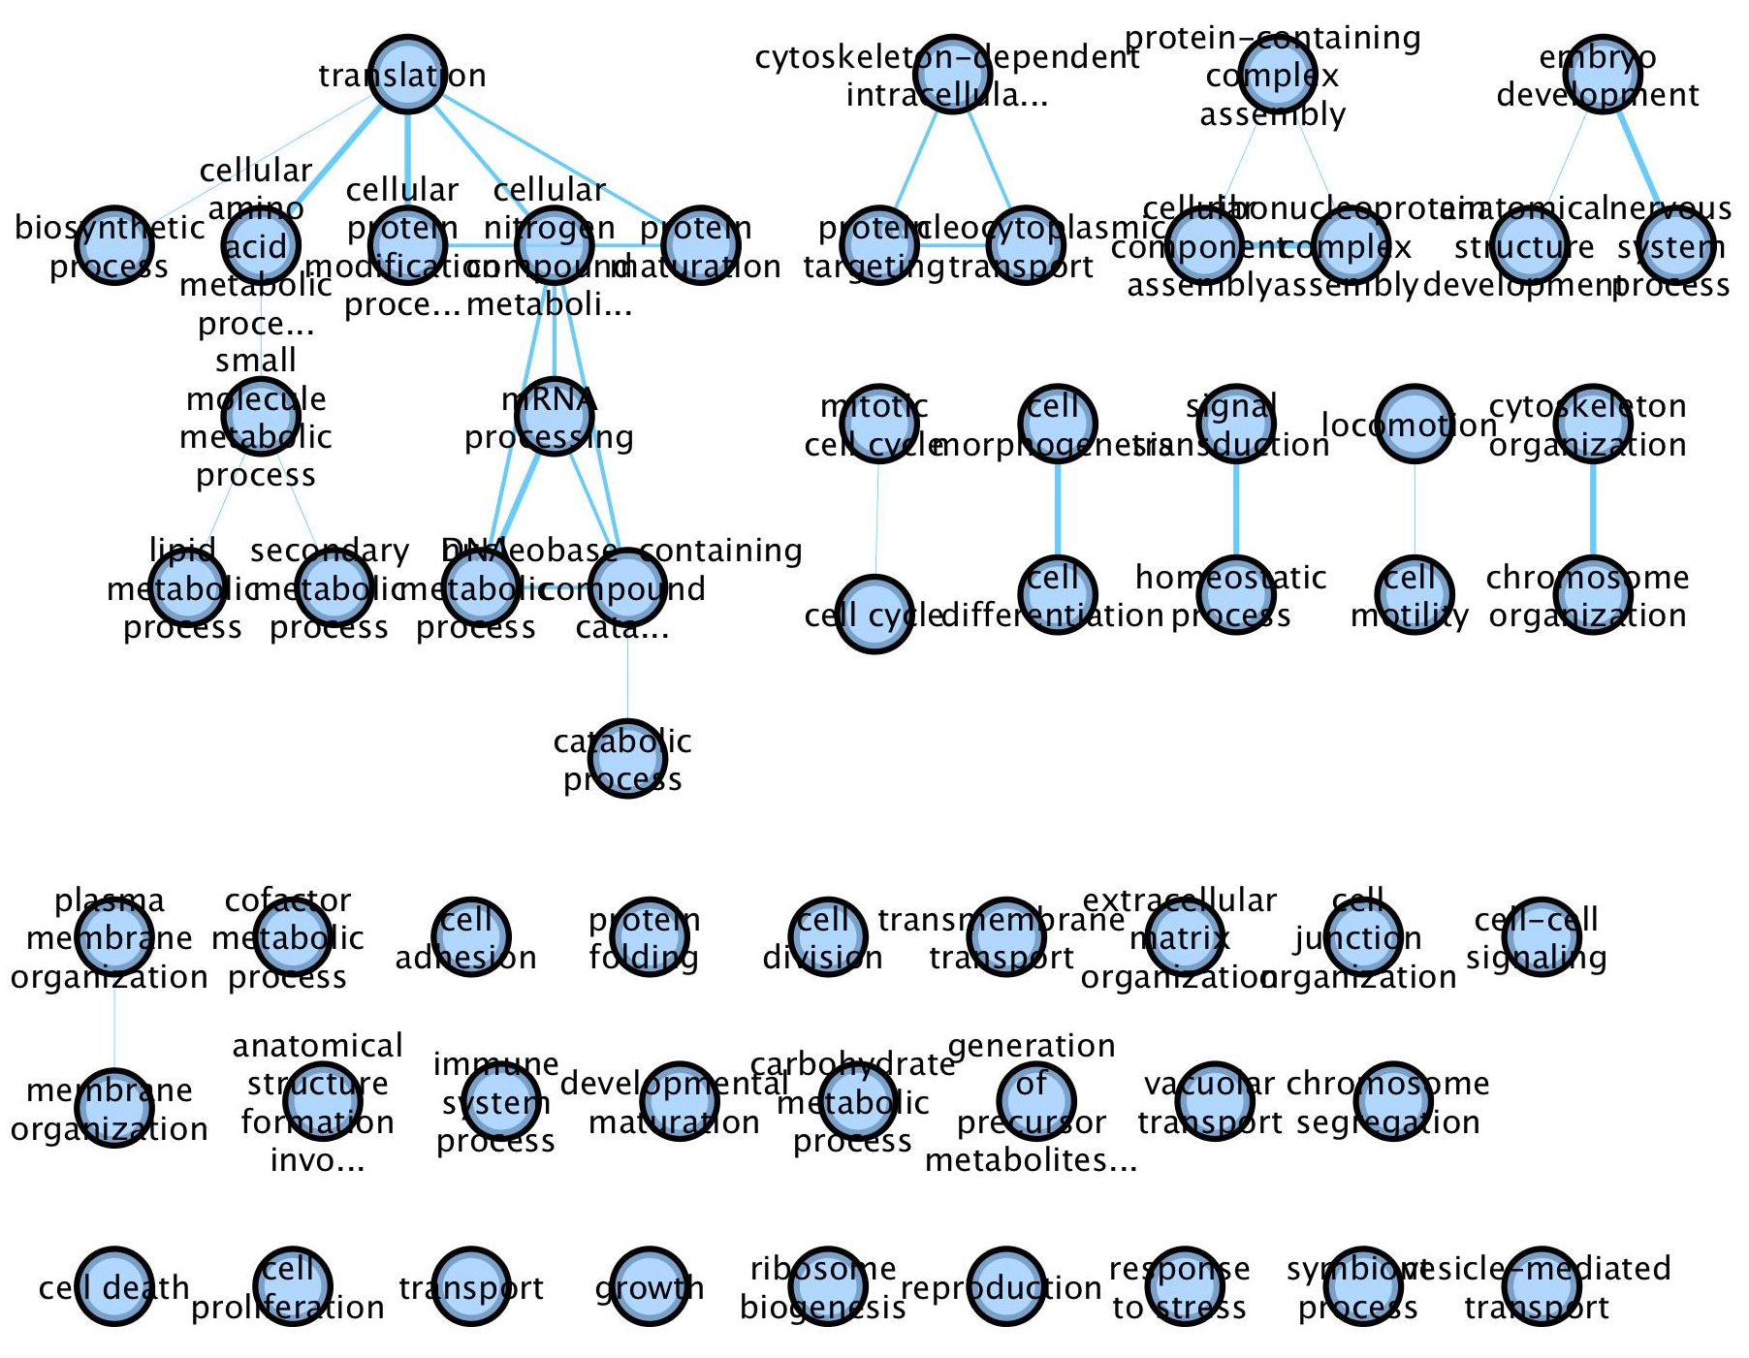
Proteomics
GO SLIM TERM CLUSTERS

Slide 3
Proteomics

Slide 4
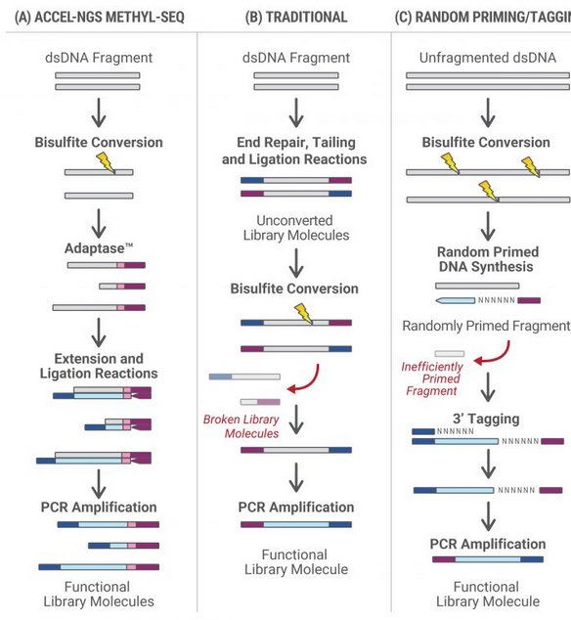
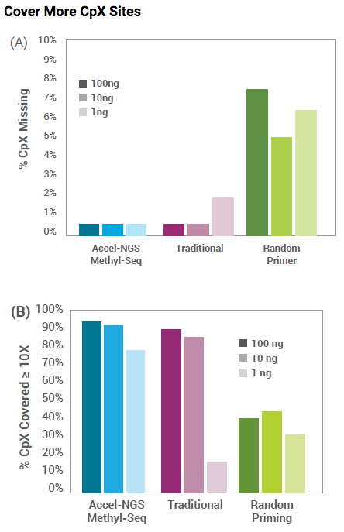
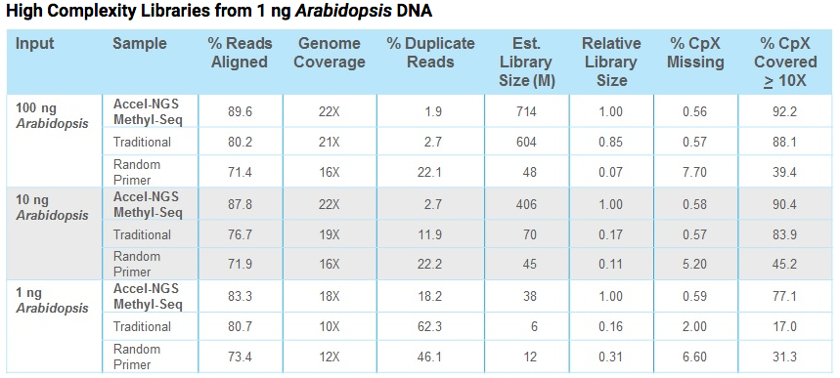
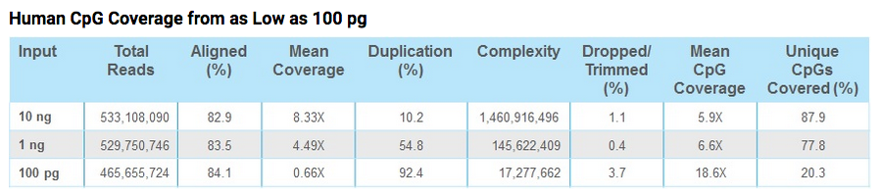
BS-sequencing on low input DNA
Swift
(Chongyuan Luo et al. Science 2017)
Diagenode's RRBS kit
Mac used for 100ng O.mykiss samples

Slide 5
Geoduck Broodstock
EXPERIMENT: variable low pH vs. ambient (6 weeks)
Upcoming events:
March 12 sample hemolymph, gonad(just to gender type), siphon(?)
March 13 last spawn
Strip spawn
Gonad slice for histo?
EXPERIMENT: constant low pH vs. ambient (~12 weeks)
saw wasting phenotype (catabolized siphons) in low pH
histology from 2 time points- low pH delays gametogenesis
need to determine assays to do with freezer samples
Samples
temporal hemolymph samples
end-of-experiment samples (ctenidia, gonad, siphon, eggs, some fert. eggs)
Assays
Glycogen assay
qPCR
Epigenetics
Transcriptomics
metabolomics
Notes:
Spent = lymphocytes? Sperm/egg outside follicle = spawned;

Slide 6
Lab data catalog
Add the data from your projects to this workbook
https://docs.google.com/spreadsheets/d/141txdaWqzaHOwKu_xd1aVrWGX6-wojHUhPrtL8XOmAU/edit?usp=sharing
Questions?
Ask on slack or github issue

